Slide 1
HOUSING: PRICE PREDICTION

Slide 2
PROBLEM STATEMENT:
Houses are one of the necessary need of each and every person around the globe and therefore housing and real estate market is one of the markets which is one of the major contributors in the world’s economy. It is a very large market and there are various companies working in the domain. Data science comes as a very important tool to solve problems in the domain to help the companies increase their overall revenue, profits, improving their marketing strategies and focusing on changing trends in house sales and purchases. Predictive modelling, Market mix modelling, recommendation systems are some of the machine learning techniques used for achieving the business goals for housing companies. Our problem is related to one such housing company.
A US-based housing company named Surprise Housing has decided to enter the Australian market. The company uses data analytics to purchase houses at a price below their actual values and flip them at a higher price. For the same purpose, the company has collected a data set from the sale of houses in Australia. The data is provided in the CSV file below.
The company is looking at prospective properties to buy houses to enter the market. You are required to build a model using Machine Learning in order to predict the actual value of the prospective properties and decide whether to invest in them or not. For this company wants to know:
• Which variables are important to predict the price of variable?
• How do these variables describe the price of the house?

Slide 3
Business Goal:
You are required to model the price of houses with the available independent variables. This model will then be used by the management to understand how exactly the prices vary with the variables. They can accordingly manipulate the strategy of the firm and concentrate on areas that will yield high returns. Further, the model will be a good way for the management to understand the pricing dynamics of a new market.

Slide 4
Technical Requirements:
Data contains 1460 entries each having 81 variables
Data contains Null values. You need to treat them using the domain knowledge and your own understanding
Extensive EDA has to be performed to gain relationships of important variable and price.
Data contains numerical as well as categorical variable. You need to handle them accordingly.
You have to build Machine Learning models, apply regularization and determine the optimal values of Hyper Parameters.
You need to find important features which affect the price positively or negatively.
Two datasets are being provided to you (test.csv, train.csv). You will train on train.csv dataset and predict on test.csv file.

Slide 5
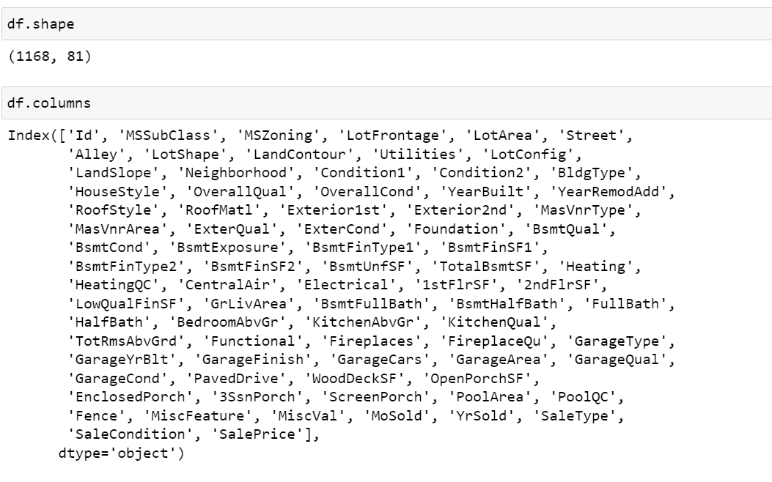
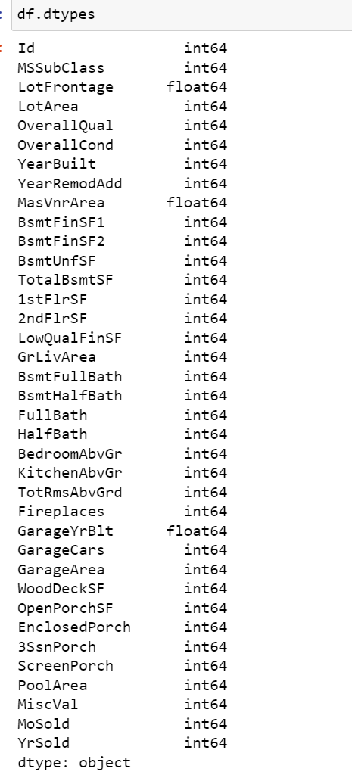
ABOUT THE DATASET:
Using various methods like df.shape, df.columns, df.head(), df.tail() , df.info(),df.nuinque to get some idea about the data we are handling

Slide 6
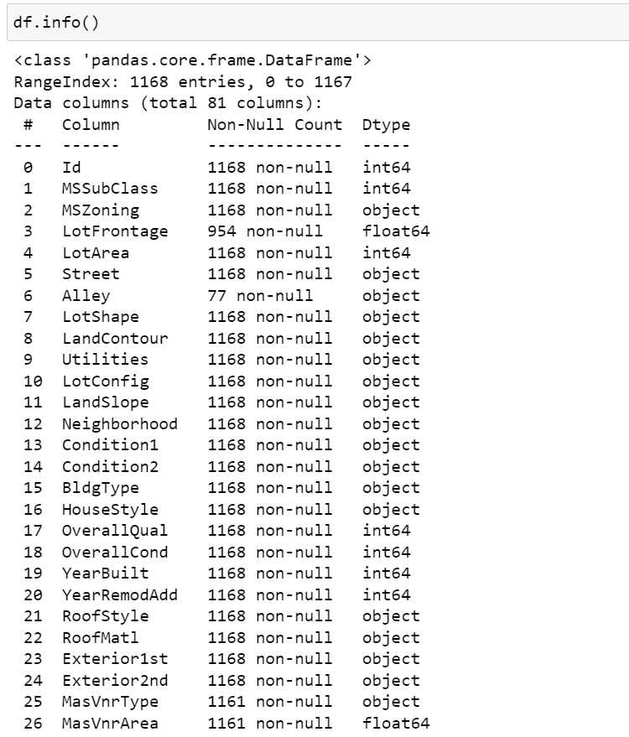
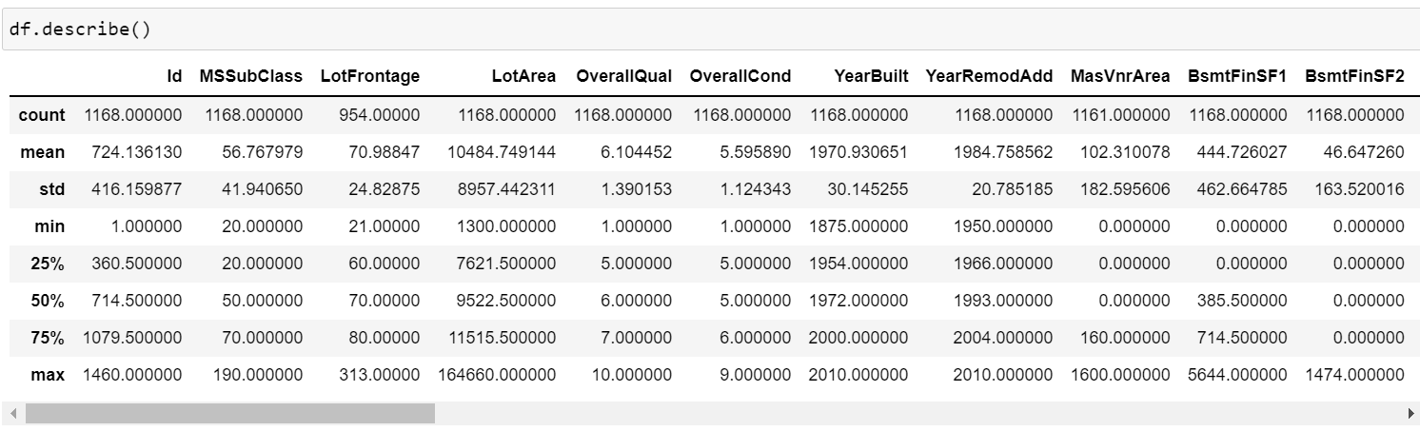
ABOUT THE DATASET:

Slide 7
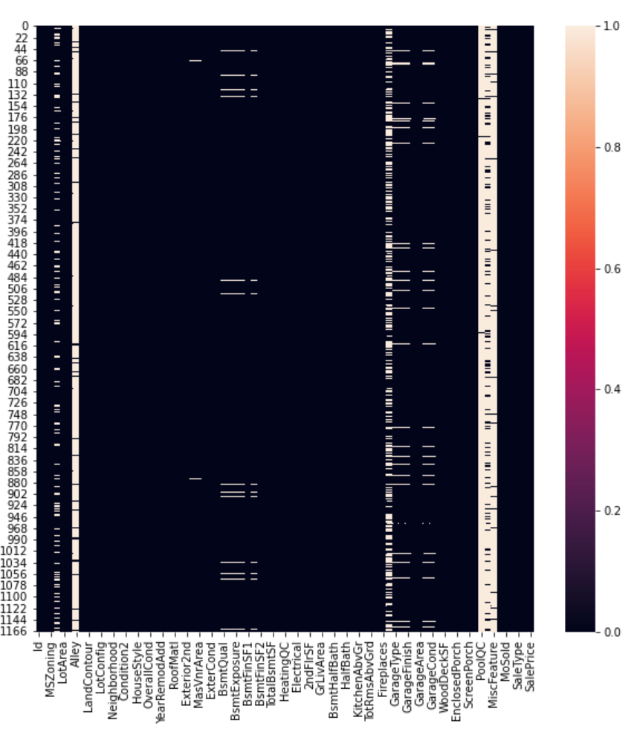
NULL VALUE CHECK:
Checking null values present in data by heatmap

Slide 8
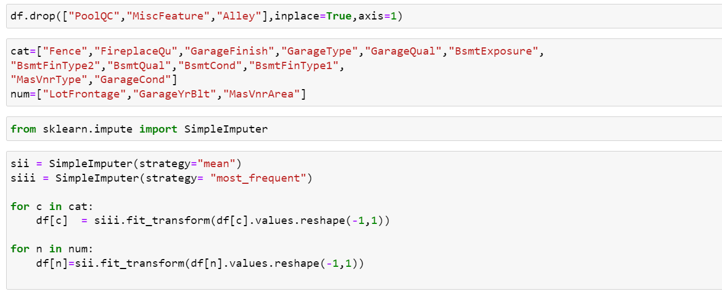
NULL VALUE TREATMENT:
NULL VALUES TREATED USING SIMPLE IMPUTER
"PoolQC","MiscFeature","Alley“ FEATURES DROPPED AS IT CONTAINS ALMOST ALL NULL VALUES

Slide 9
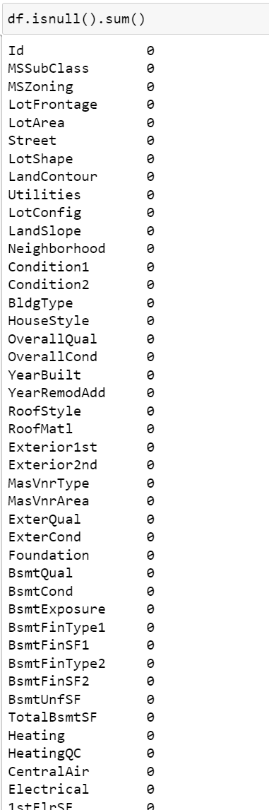
NULL VALUE TREATMENT:
NULL VALUES ARE REMOVED

Slide 10
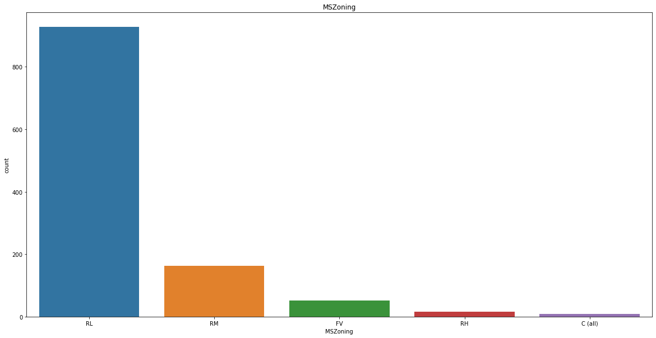
UNIVARIATE ANALYSIS:
Using for loop to plot pie chart for all columns

Slide 11
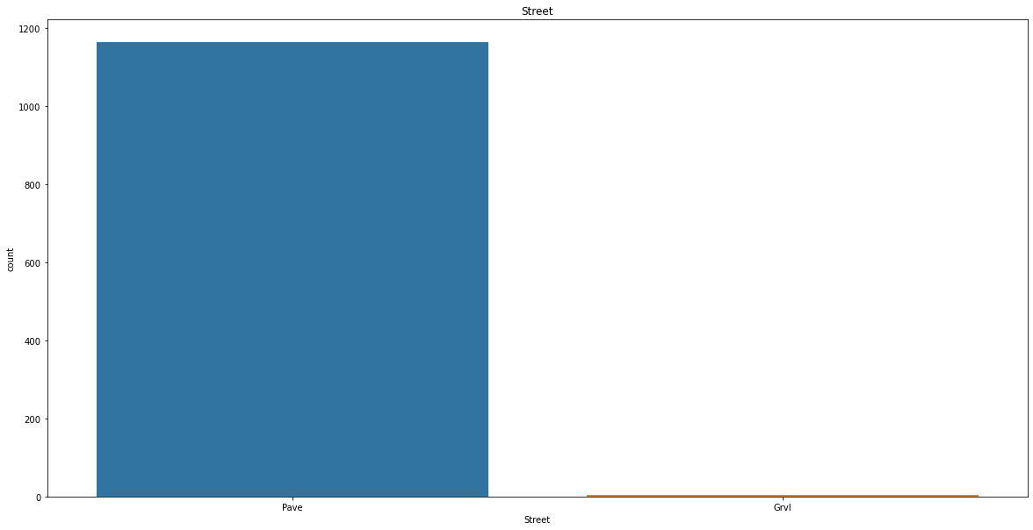
UNIVARIATE ANALYSIS:

Slide 12
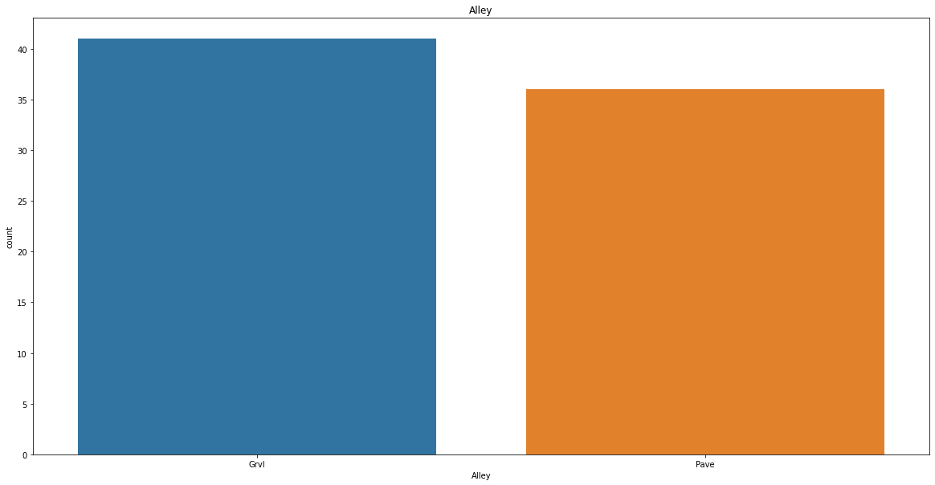
UNIVARIATE ANALYSIS:

Slide 13
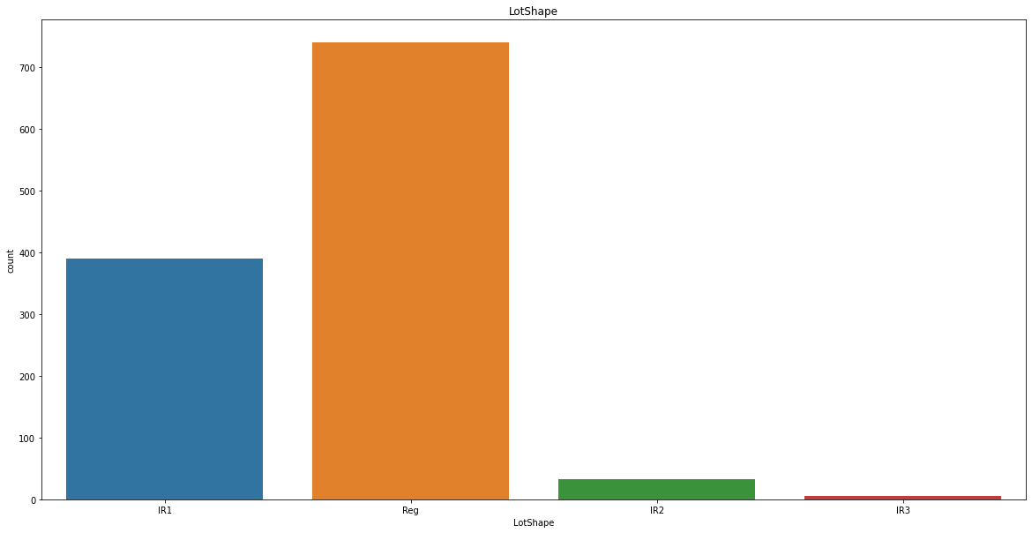
UNIVARIATE ANALYSIS:

Slide 14
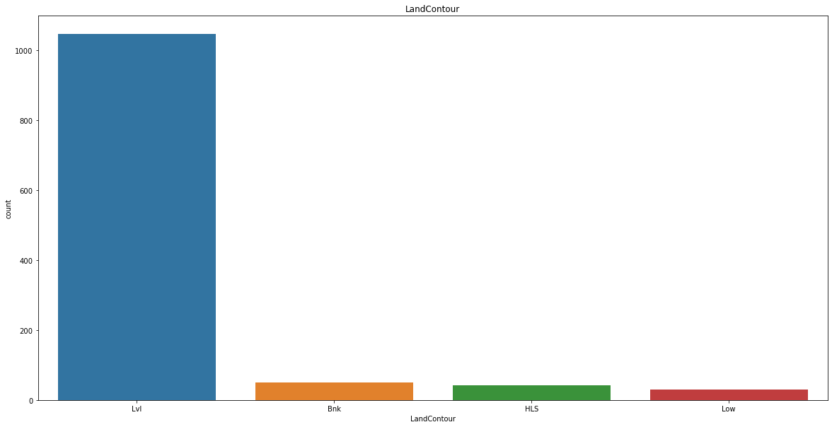
UNIVARIATE ANALYSIS:

Slide 15
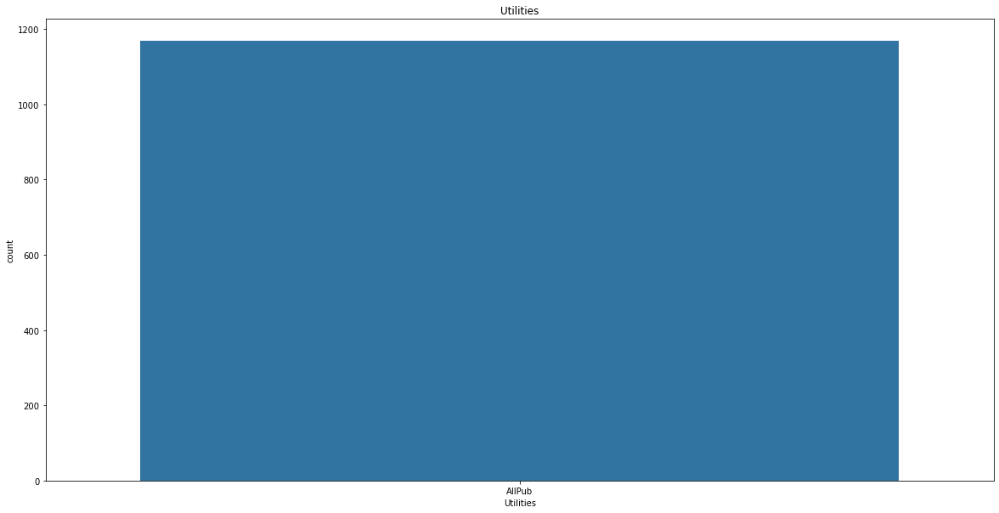
UNIVARIATE ANALYSIS:

Slide 16
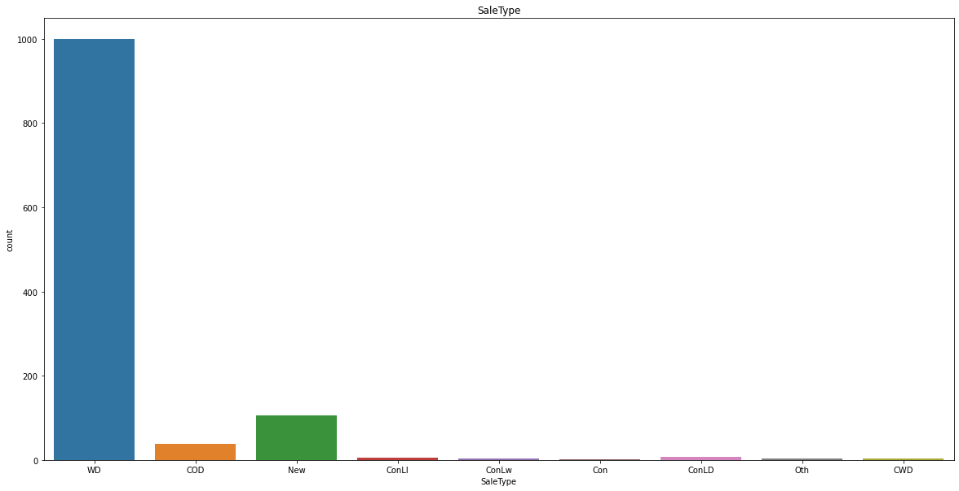
UNIVARIATE ANALYSIS:

Slide 17
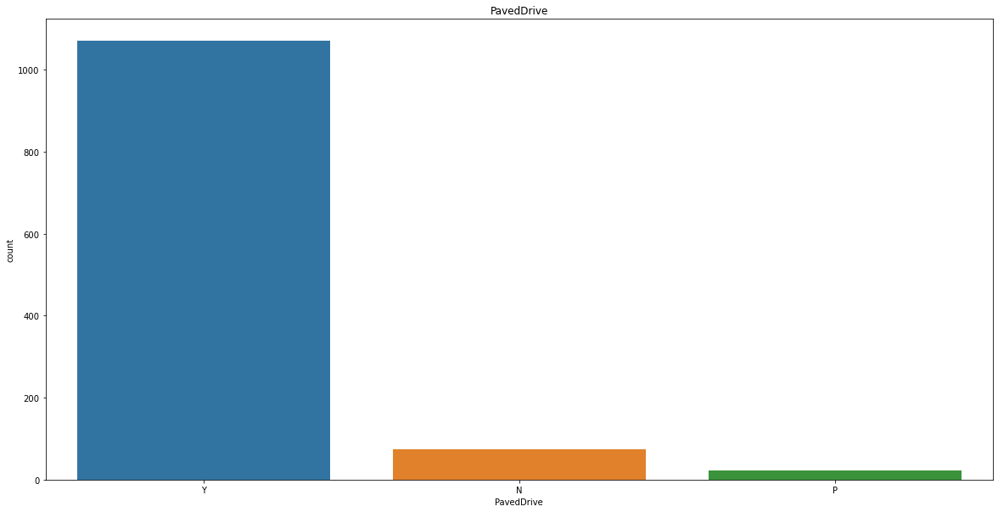
UNIVARIATE ANALYSIS:

Slide 18
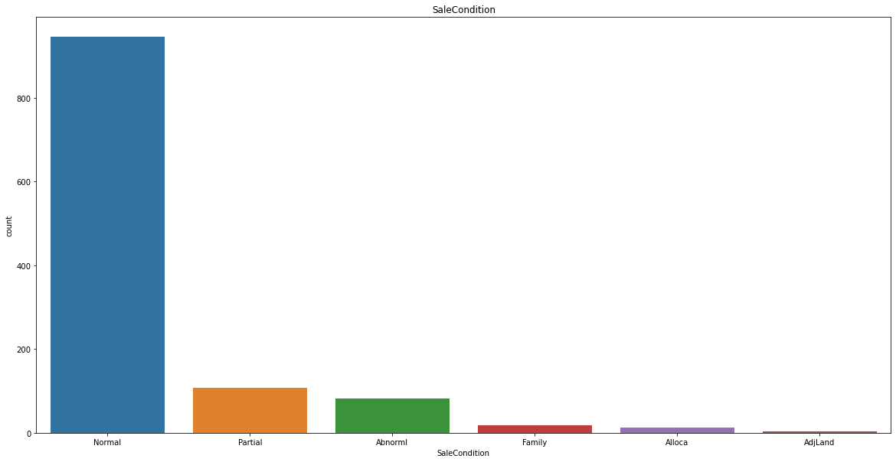
UNIVARIATE ANALYSIS:

Slide 19
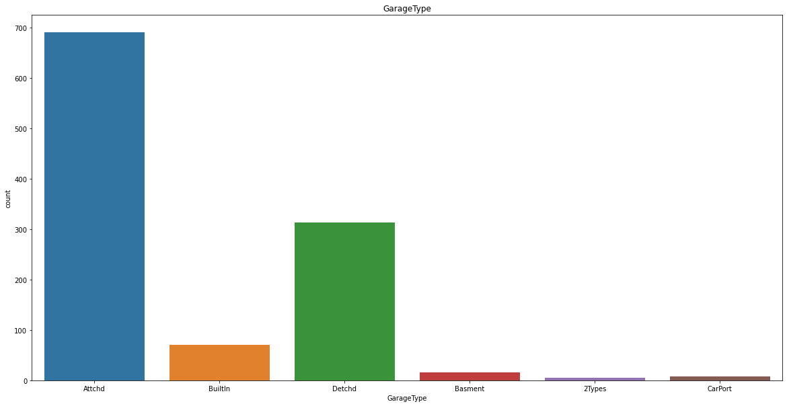
UNIVARIATE ANALYSIS:

Slide 20
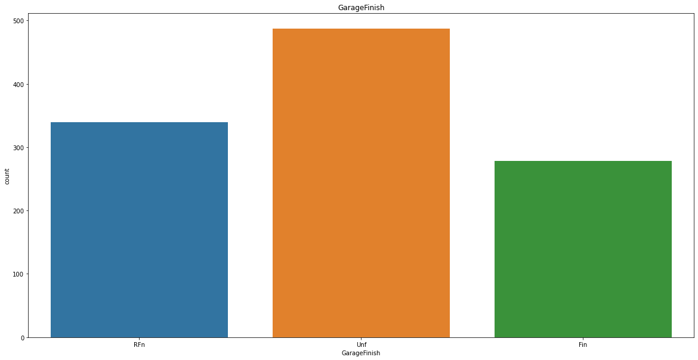
UNIVARIATE ANALYSIS:

Slide 21
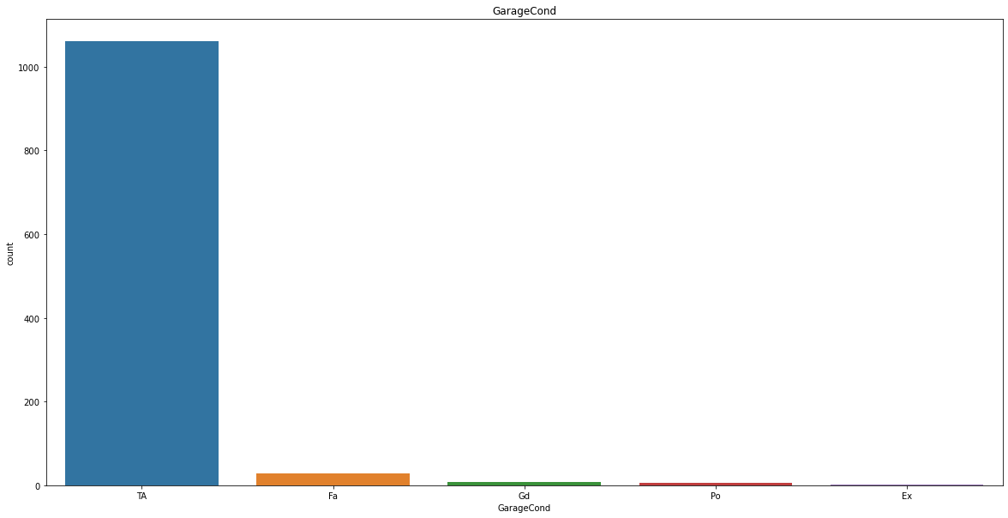
UNIVARIATE ANALYSIS:

Slide 22
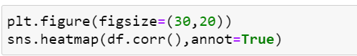
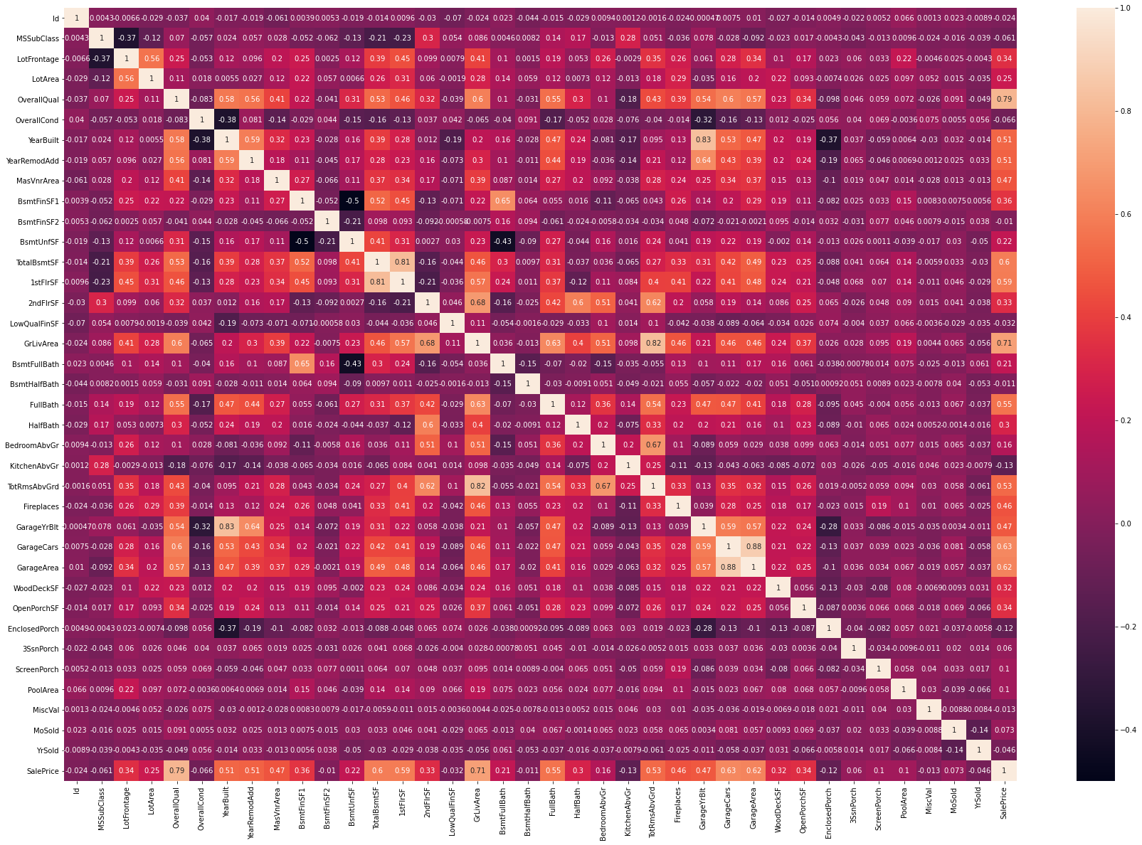
CORRELATION ANALYSIS:

Slide 23
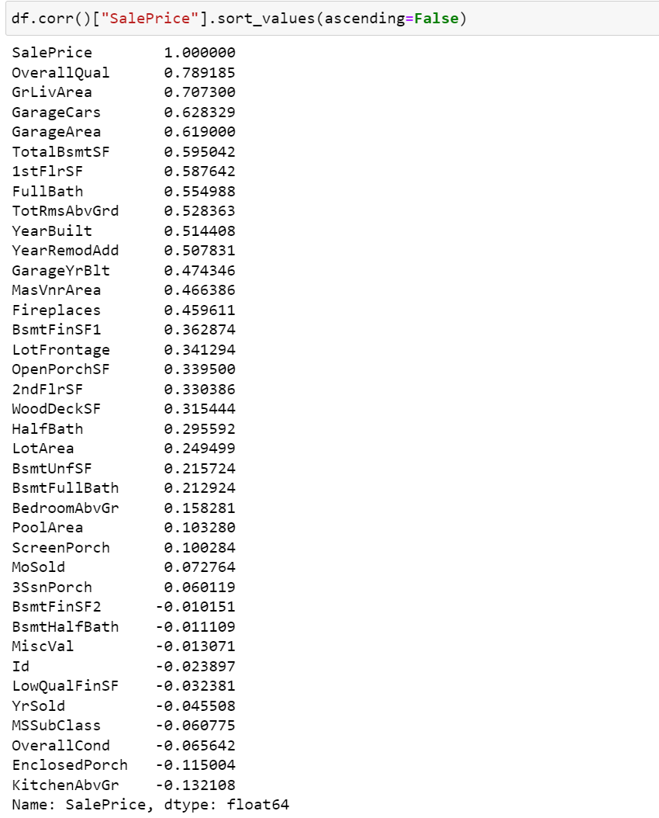
CORRELATION ANALYSIS:

Slide 24
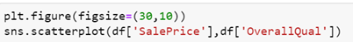
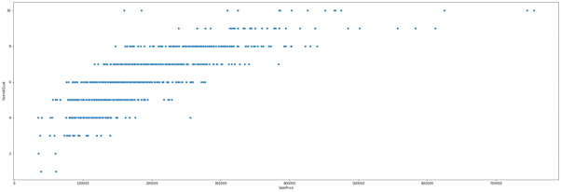
BIVARIATE ANALYSIS:
Observation:
OverallQual is Positively Correlated to Sale Price. with increase in Overall Quality the Sale Price also increases

Slide 25
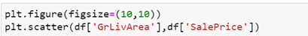
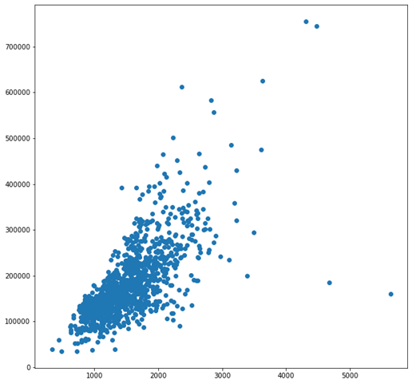
BIVARIATE ANALYSIS:
Observation:
(ground) living area square feet increases the Sale Price also Increases. Strong positive correlation

Slide 26
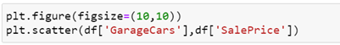
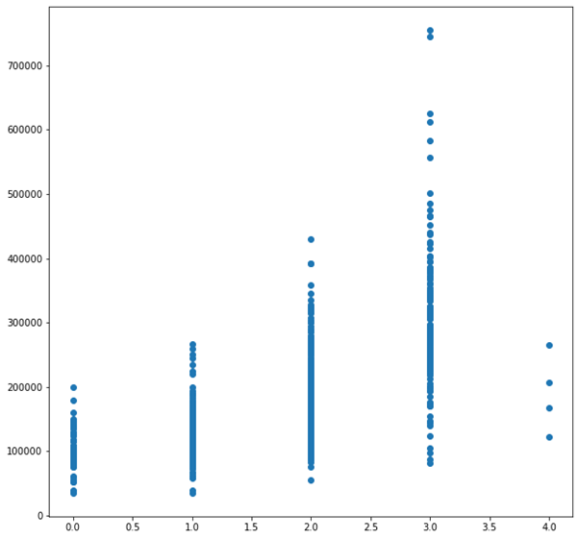
BIVARIATE ANALYSIS:
Observation:
Garage Car Capacity in terms of cars is Highly Positively Correlated to House price.

Slide 27
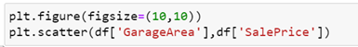
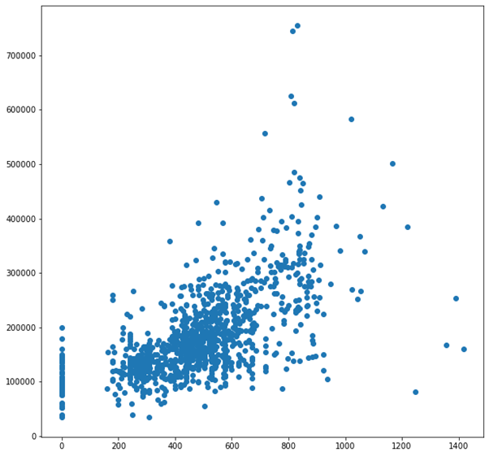
BIVARIATE ANALYSIS:
Observation:
Garage Area is also Highly Positively correlated to House price. it seems people prefer more garage space

Slide 28
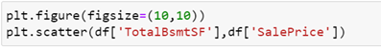
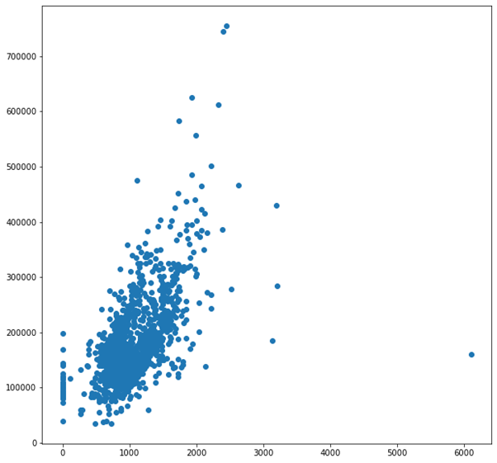
BIVARIATE ANALYSIS:
Observation:
Basement Area is also Positively Correlated to Sale Price . People prefer extra spacious basement

Slide 29
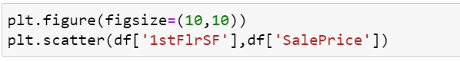
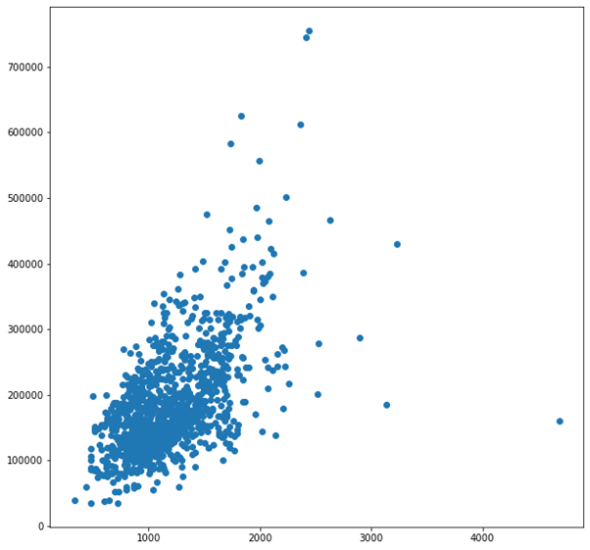
BIVARIATE ANALYSIS:
Observation:
First Floor in Square feet is also Positively Correlated to Sale Price. higher Square feet of first floor more space for the house

Slide 30
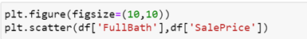
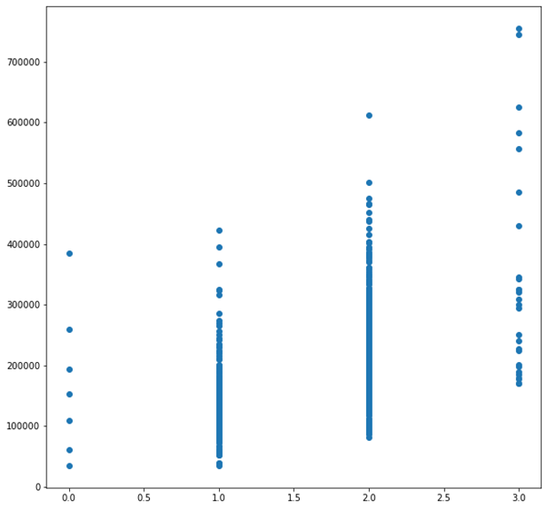
BIVARIATE ANALYSIS:
Observation:
As the Full bathroom above ground increases the Price of house also increases its strong positive correlation

Slide 31
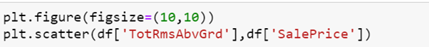
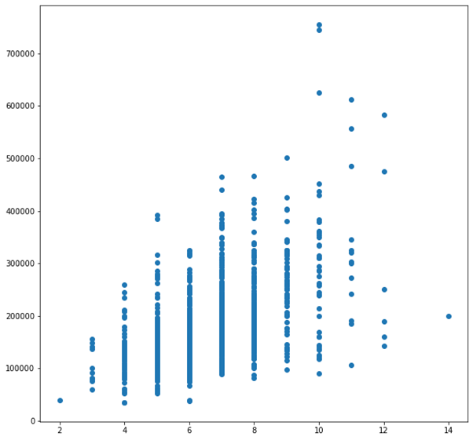
BIVARIATE ANALYSIS:
Observation:
As total rooms above ground increases the Price also increases strong positive correlation

Slide 32
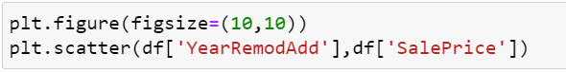
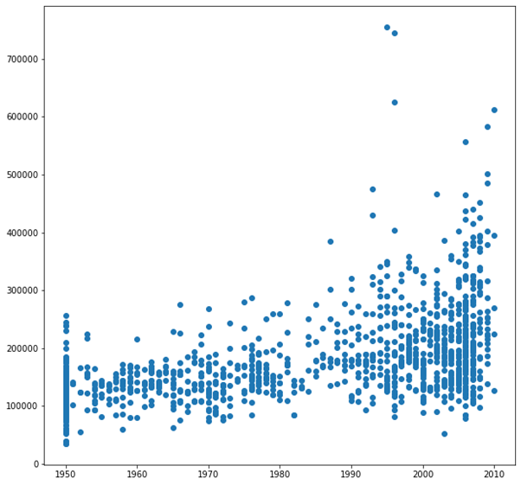
BIVARIATE ANALYSIS:
Observation:
as the remodelling or alteration Date increases the price also increases people want house to be reliable

Slide 33
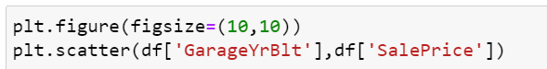
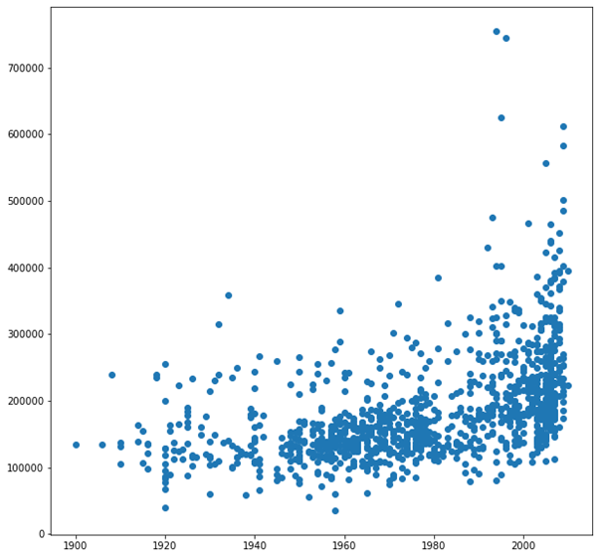
BIVARIATE ANALYSIS:
Observation:
As the Garage built year increases the price of the house also increases

Slide 34
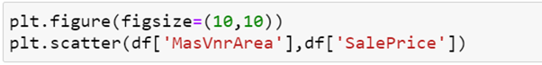
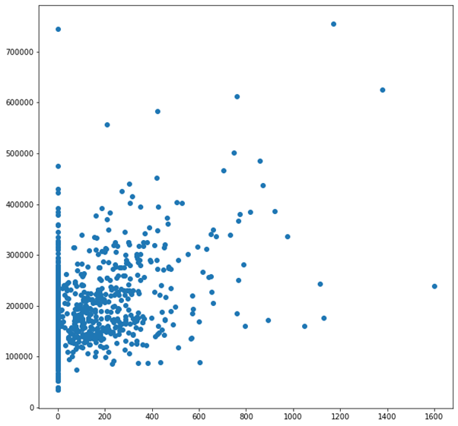
BIVARIATE ANALYSIS:
Observation:
Masonry veneer area increases the price also increases

Slide 35
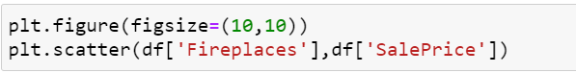
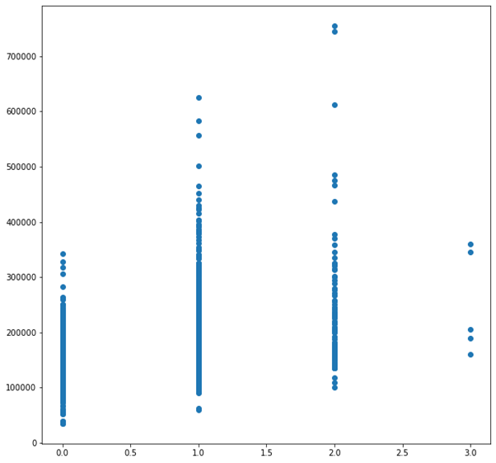
BIVARIATE ANALYSIS:
Observation:
as the number of fireplaces increases the price also increases

Slide 36
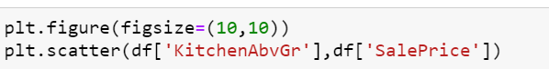
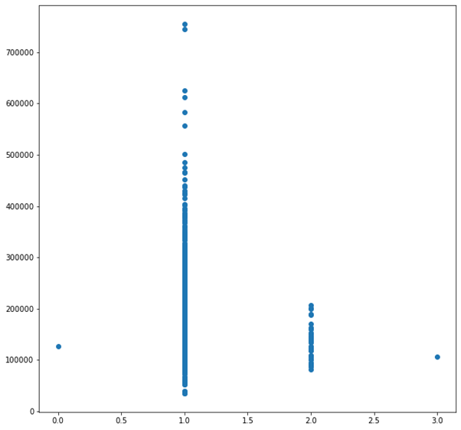
BIVARIATE ANALYSIS:
Observation:
as the kitchen above ground increases the price drops negative correlation.

Slide 37
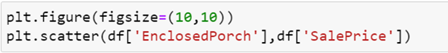
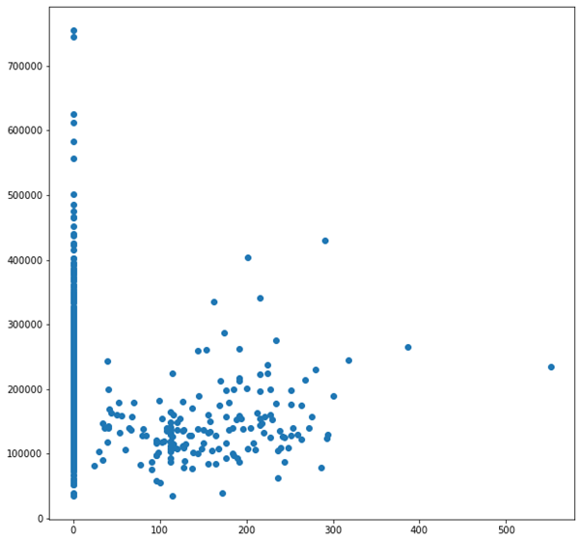
BIVARIATE ANALYSIS:
Observation:
as the enclosed porch area increases the price decreases negative correlation

Slide 38

ENCODING
DATA CONTAINS OBJECT DATA SO WE ARE ENCODING WITH DUMMIES METHOD AS DATA HAS NO ORDINAL RELATIONSHIP

Slide 39

ENCODING:

Slide 40

ENCODING:
WE HAVE ENCODED THE DATA

Slide 41


SKEWNESS:
We can see data have skewness so now we proceed to remove it
By using power_transform skewness in the data is removed

Slide 42

OUTLIERS:
We can see there are outliers in this data . So we use z score method to remove outliers. I use z>4 as z>3 the data loss is more than 30%

Slide 43

OUTLIERS:

Slide 44

Creating categorical dataframe for pd.get dummies we created earlier and dropping the outlier rows in them

Slide 45

Standardizing the numerical data before feeding to PCA

Slide 46

Now we check how many No of columns we need to retain all information

Slide 47


We need 127 columns to retain most of the information in data

Slide 48

We have converted the data to 127 columns

Slide 49


MODEL TRAINING

Slide 50

MODEL TRAINING

Slide 51

MODEL TRAINING
RIDGE REGRESSION PERFORMED BEST COMPARED TO ALL

Slide 52

HYPERPARAMETER TUNING
USING GRID SEARCH CV TUNING RIDGE REGRESSION MODEL

Slide 53

HYPERPARAMETER TUNING

Slide 54

SAVING THE MODEL

Slide 55


PREDICTING THE HOUSE PRICE WITH TEST DATA SET
APPLYING ALL THE PREPROCESSING TECHNIQUES WE USED ON EARLIER DATA SET IN TEST DATA SET.
HANDLING NULL VALUES

Slide 56

APPLYING ALL THE PREPROCESSING TECHNIQUES WE USED ON EARLIER DATA SET IN TEST DATA SET
ENCODING

Slide 57

APPLYING ALL THE PREPROCESSING TECHNIQUES WE USED ON EARLIER DATA SET IN TEST DATA SET
SKEWNESS REMOVAL

Slide 58

APPLYING ALL THE PREPROCESSING TECHNIQUES WE USED ON EARLIER DATA SET IN TEST DATA SET
OUTLIERS REMOVAL

Slide 59

APPLYING ALL THE PREPROCESSING TECHNIQUES WE USED ON EARLIER DATA SET IN TEST DATA SET
STANDARD SCALER

Slide 60

APPLYING ALL THE PREPROCESSING TECHNIQUES WE USED ON EARLIER DATA SET IN TEST DATA SET
PCA

Slide 61

NOW WE ARE IMPORTING THE SAVED MODEL WE TRAINED ON TRAINING DATASET AND USE IT TO PREDICT HOUSE PRICE ON TEST DATA SET

Slide 62
CONCLUSION:
Key Findings and Conclusions of the Study
I can clearly see the correlation of size variables to price. The size variables I mean are house square feet, first floor square feet, garage area, basement square feet, No of Fireplaces, no of bathrooms. as the size of them increases price increases along with them there is strong positive correlation with size variables I mentioned above. People are obsessed with size of the house.
Learning Outcomes of the Study in respect of Data Science
As I mentioned earlier the size is directly proportional to Price. The best algorithm for this dataset is Ridge Regression. Although initially the testing score is 80% and Cross Validation Score is 86%. With the help of grid Search I can clock the Testing Score to 87% and Cross Validation Score to 87%
Limitations of this work and Scope for Future Work
The Limitations are some of the Categorical data may have ordinal relationship but we considered they don’t have ordinal relationship so in future someone with in depth industry knowledge may distinguish the data and encode them

Slide 63
THANK YOU FOR THE OPPORTUNITY :

